Slide 1
Software Engineering IT4012
Requirement Engineering

Slide 2
Learning Objectives
Understand requirements engineering concepts
Identify types of requirements
Explain RE process
Understand elicitation, specification, validation ,management

Slide 3
What is a Requirement?
Description of system services
Constraints on system operation
Reflects customer needs

Slide 4
What is Requirements Engineering ?
Process of
Discovering requirements
Analyzing requirements
Documenting requirements
Validating requirements

Slide 5
Importance of RE
Foundation of software development
Reduces project failure
Improves communication
Saves cost and time

Slide 6
Types of Requirements
User Requirements
System Requirements
Functional Requirements
Non-functional Requirements

Slide 7

User Requirements
High-level descriptions
Written in natural language
For customers and users

Slide 8
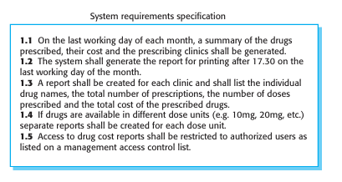
System Requirements
Detailed technical descriptions
Used by developers
Define system behavior precisely

Slide 9
Functional Requirements
What the system should do
Example-
“System shall allow user login”

Slide 10
Functional Requirements (Examples)
User authentication
Data processing
Report generation

Slide 11
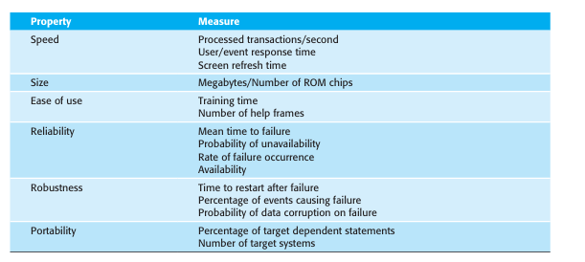
Non-Functional Requirements
Constraints on system
Define system quality

Slide 12
Types of Non-Functional Requirements
Product (performance, reliability)
Organizational (standards, policies)
External (legal, regulatory)

Slide 13
Examples of Non-Functional Requirements
Performance: response time < 2 sec
Security: authorized access only
Usability: easy to learn

Slide 14
RE Process Overview
Elicitation
Specification
Validation
Management

Slide 15
Requirements Elicitation
Gathering requirements from stakeholders
Understanding user needs

Slide 16
Elicitation Challenges
Stakeholders unclear
Conflicting requirements
Communication gaps
Changing environment

Slide 17
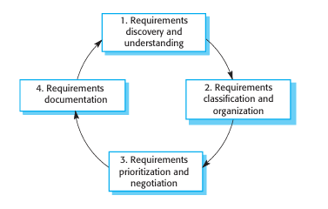
Elicitation Activities
Discovery
Classification
Negotiation
Documentation

Slide 18
Common Elicitation Techniques
Interviews
Questionnaires and Surveys
Workshops and Brainstorming
Use Cases and User Stories
Prototyping
Observation
Document Analysis

Slide 19
Requirements Specification
Converting requirements into document
Creates Software Requirements Specification (SRS)

Slide 20
Types of Specification
Natural language
Structured language
Graphical models (UML)
Mathematical models

Slide 21
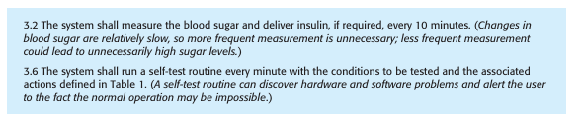
Natural Language

Slide 22
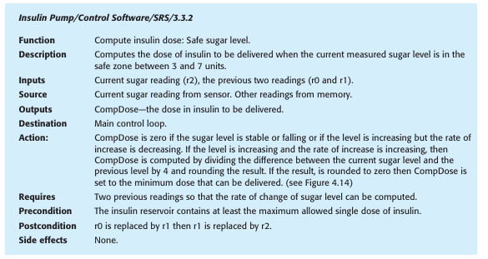
Structured Specification

Slide 23
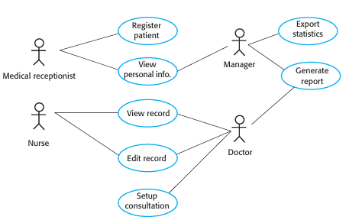
Graphical Models-Use case

Slide 24
Good Specification Practices
Use standard format
Use “shall” for mandatory
Avoid ambiguity
Keep it simple

Slide 25
Requirements Validation
Check correctness of requirements
Ensure system meets user needs

Slide 26
Validation Checks
Validity
Consistency
Completeness
Realism
Verifiability

Slide 27
Validation Techniques
Reviews
Prototyping
Test-case generation

Slide 28
Requirements Management
Managing changing requirements
Tracking requirement changes

Slide 29

Change Management Process
Problem analysis
Change analysis & costing
Implementation

Slide 30
Summary
RE is critical in software development
Requirements must be clear and testable
Process is iterative
Good RE reduces risks

